Slide 1
MSAW Engine Web
Cheol Young Park & Shou Matsumoto
3/7/2017

Slide 2
Module 1: MSAW Engine Web

Slide 3
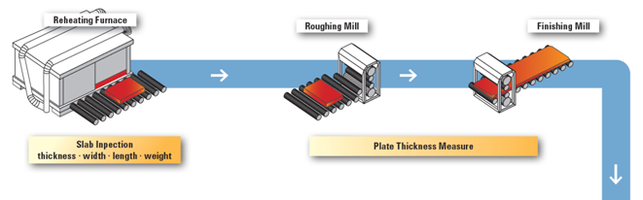
Multiple Objectives
Quality
Reduce thickness error
Improve flatness
Reduce Crack
Productivity
Reduce energy
Reduce time
Sensor
Temperature
Speed
Weight
Size
Readiness
…
Smart Steel-Plate Development System
Controller
Pass schedule
Roll gap
Roll pressure
Torque
Reduction Rate
…
Sensor Module
Control Module

Slide 4
Sensor
Temperature
Speed
Weight
Size
Readiness
…
Item 1
Item 2
Input 1
Process 1
Process 2
Process 3
Ouput1
Control 1
Control 2
Control 3
Controller
Pass schedule
Roll gap
Roll pressure
Torque
Reduction Rate
…
Multiple Objectives
Quality
Reduce thickness error
Improve flatness
Reduce Crack
Productivity
Reduce energy
Reduce time

Slide 5
Function 1: Real-time optimal manufacturing condition analysis
Item 1
Input 1
Process 1
Process 2
Ouput1
Control 1
Control 2
Approach 1: In the real-time optimal manufacturing condition analysis using the Bayesian network, if the target output value (Ouput1) is set in a certain manufacturing process, the control value (Control 1 & 2) is automatically set in correspondence with the input value Find function.
Approach 2: Given constant inputs, changing controls will influence the outputs. We find a desirable output with such changing. Thus, simulating or searching controls for outputs.

Slide 6
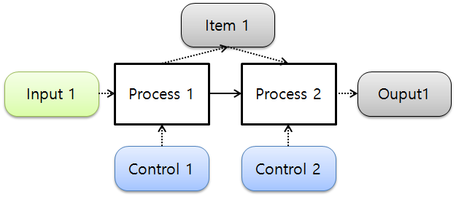
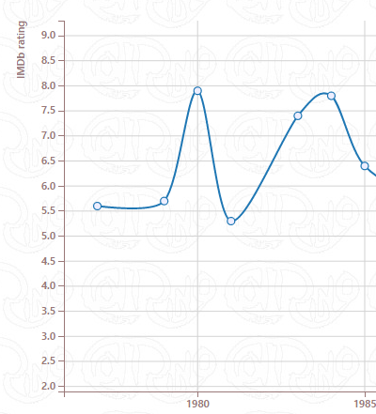
Function 1: Steps
Step 1. Select an output RV
Step 2. Put a value
5
Step 3. Run
Step 4. Sensor data are set
5
2
5
Step 5. Reasoning module finds control values
Step 6. Showing
simulation results
2
5
RV1: 1 2 3 4 5 6 7
RV2: 12 12 12 12 12 12 12
3
1

Slide 7
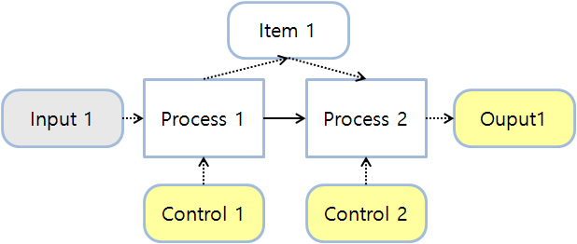
Function 2: Prediction and alarm of manufacturing situation
T = 0
T = 1
T = 2
Ouput1
= Average 60 standard deviation 10
Ouput1
= Average 70 standard deviation 10
Ouput1
= Average 88 standard deviation 10
The forecasting and alarming of the manufacturing situation using the multi-Bayesian network is a function of informing the situation when the output value (Ouput1) of a certain output varying over time goes out of a certain range
For example, in the above figure, for the current time T = 0, the inference engine generates a model with T = 1 and T = 2 and observes the predicted output value (Output1) continuously. If the estimated output value (Output1) exceeds the predetermined range (0 <Output1 <80), the status is notified. That is, "predicted output value exceeds 80 at T = 2“

Slide 8
Function 2: Steps
Step 2. Set evidence & Reasoning
Step 1. Set a time
T = 5
T = 4
VF
5
VF
T = 5
5
Step 3. Check a value in the value function
T = 4
T = 5
VF
If value < 1, alarm

Slide 9
Function 3: Analysis of Manufacturing Element Relationship
Item 1
Input 1
Red means high impact
Input 2
Process 1
Process 2
Ouput1
Input 3
Item 2
Factor analysis is a function that analyzes which nodes (Input, Item, Output) are affected by other nodes
For example, the output value (Ouput1) shows how much the remaining nodes are affecting each other numerically
Approach 1: Sensitivity Analysis can be used to find a variable whose change influence the output highly. Change the value of each node. Measure the change of the output for how much it was changed.
Approach 2: Most Probable Explanation (MAP approach)/Max Propagation. This approach finds all values highly influencing the outputs.

Slide 10
Function 3: Steps
Step 1. Select RV
Step 2. Put a value
5
Step 3. Run cause analysis
5
3
1

Slide 11
MSAW Engine Web
Canvas
Nodes [Discrete, Continuous]
Name
Color
Type
Additional information
…
Edges
Name
Color
Type
…
Like D3, Node-RED, http://www.nomnoml.com/
http://www.cotrino.com/starpaths/
Draw Nodes given a cyber factory system (CFS) file
Update Nodes given reasoning results

Slide 12

MSAW Engine Web Nodes
e.g., Discrete
e.g., Continuous
Name
Name
Default:
55%
StateA
10
5
15
Name
55%
Name
StateA
Extended:
15%
StateB
30%
StateC

Slide 13

MSAW Engine Web Example
Process 1
Process 2
Process 3
…

Slide 14
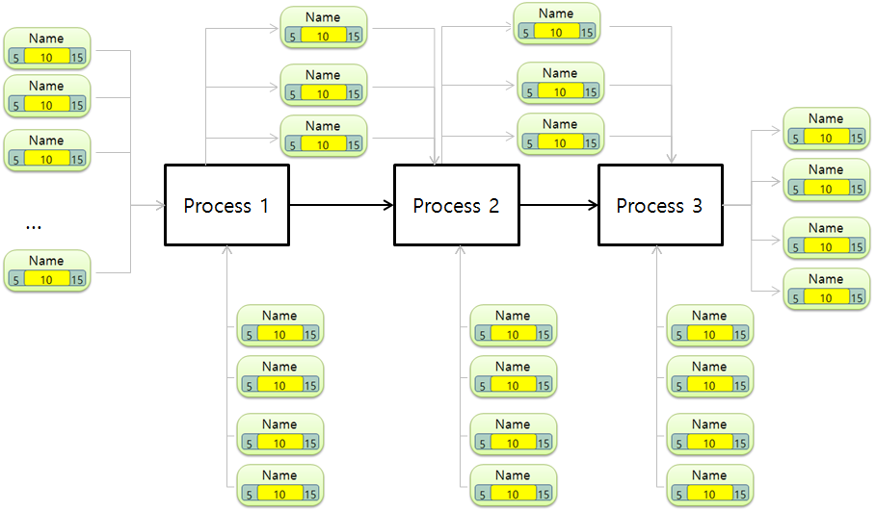
MSAW Engine Web Console Example
Nodes:
N1
N2:
Distribution
Buttons

Slide 15
MSAW Engine Structure
Response Analysis Result
Response Analysis Result
MSAW Engine (JAVA)
MSAW Engine Web (JSP)
MSAW System
(JSP)
Ajax
REST Ful
Request Analysis
Request Analysis

Slide 16
Development method
Java, JSP, Ajax, Json, Github(?), MySQL, (No PHP)
Each class/web page requires a test example
Complete this module until 4/30

Slide 17
Example data schema
Slab / Plate |  |  |  | RM Setting |  |  | Heater |  |  | Environment
Slab no. (SID) / Plate no. (PID) |  | 1 |  | RM Work Roll Diameter (RMWRD) | 1207 |  | Slab amount (SA) | 10 |  | Environmental temperature (ET) | 15
Component Composition (CC) | C | 0.177 |  | RM ER Diameter (RMERD) | 1002 |  | Production time (per slab) (PT) | 60 |  | Gas (GS) | 0
 | SI | 0.185 |  | Number of jobs after RM roll replacement (NRR) | 00047 |  | Target temperature for a slab (TT) | 1107 |  | Other1 (EV_OH1) | 0
 | MN | 0.414 |  | Amount of work after RM roll replacement (ARR) | 588900 |  | total energy (TE) | 1100110
 | P | 0.01 |  | Other1 (RMS_OH1) | 0 |  | Other1 (HT_OH1) | 0
 | S | 0.003
 | CU | 0.013 |  | RM Roll Work
 | NB | 0 |  | Slab thickness (STH) | 300.00
 | V | 0 |  | Slab width (SWT) | 1700
 | NI | 0.01 |  | Slab length (SLN) | 4950
 | MO | 0 |  | Slab temperature (STEMP) | 1107
 | CR | 0.01 |  | Material hardness (MH) | 75921
 | AL | 0.025 |  | Pressure force (PF) | 4464
 | TI | 0.001 |  | Torque (TQ) | 483
Slab thickness (STH) |  | 30000 |  | Roll Gap (RG) | 280.25
Slab width (SWT) |  | 1700 |  | Rolling Speed (RS) | 2
Slab Length (SLN) |  | 4950 |  | Pressure hardness (PH) | 90
Weight (WT) |  | 19740 |  | Reduction Amount (RA) | 17.25
Slab temperature (STEMP) |  | 1107 |  | Reduction Rate (RR) | 0,058
temperature distribution (TD) |  | 100 |  | Reduction Speed (RSPD) | 2.09
foreign substance (FS) |  | 0 |  | RM start time (RM_ST) | 20:37:15
shape (SH) |  | 0 |  | RM end time (RM_ET) | 20:39:3
bubble (BB) |  | 0 |  | RM working time (RM_WT) | 103.54
Other1 (SP_OH1) |  | 0 |  | Passing Time (RM_PT) | 18.31
 |  |  |  | Cooling water temperature (CWTEMP) | 10
 |  |  |  | Cooling water speed (CWS) | 12
 |  |  |  | Work roll state (WRS) | 100
 |  |  |  | Other1 (RMW_OH1) | 0

Slide 19
Module 2: HMLP Engine Web

Slide 20


1. Upload Data
Upload an excel data or a relational data
Upload

Slide 21
2. Create a World Model
Add MFrags and Variables
MTheory: RDB_Name
[F: Table_A
[C : Isa( ka, KeyA)]
[R:AttributeA]
]
[F: MFrag_B
[C : Isa( kb, KeyB)]
[R:AttributeB1, AttributeB1] Error: same name
]
[F: MFrag_B
[C : Isa( kb, KeyB)] [R:AttributeB1, AttributeB1]
]
Add

Slide 22
3. Create Rules
Add Rules
MTheory: RDB_Name
[F: Table_A
[C : Isa( ka, KeyA)]
[R:AttributeA]
]
[F: MFrag_B
[C : Isa( kb, KeyB)]
[R:AttributeB1
[IP:AttributeA]
]
]
AttributeA -> AttributeB1
Add

Slide 23
4. Update CLD
Edit CLD for variables
MTheory: RDB_Name
[F: Table_A
[C : Isa( ka, KeyA)]
[R:AttributeA
[L: Categorical]
]
]
[F: MFrag_B
[C : Isa( kb, KeyB)]
[R:AttributeB1
[IP:AttributeA]
[L: Categorical]
]
]
Name New_CLD_1
if some v have (VehicleType = Tracked) [
High = 0.3, Low = 0.7
] …
Add

Slide 24
5. Set Joining Context
Set SQL where script
MTheory: RDB_Name
[F: Table_A
[C : Isa( ka, KeyA)]
[R:AttributeA
[L: Categorical]
]
]
[F: MFrag_B
[C : Isa( kb, KeyB)]
[W: Where ka = kb ]
[R:AttributeB1
[IP:AttributeA]
[L: Categorical]
]
]
Where ka = kb
…
Add

Slide 25
6. Learn a MEBN model
Apply MEBN learning algorithm
MTheory: RDB_Name
[F: Table_A
[C : Isa( ka, KeyA)]
[R:AttributeA
[L: Categorical]
]
]
[F: MFrag_B
[C : Isa( kb, KeyB)]
[W: Where ka = kb ]
[R:AttributeB1
[IP:AttributeA]
[L: Categorical]
]
]
Learned MTheory:
[F1: Mti_condition
[C: Isa (v, VEHICLE), Isa (mti, MTI), Isa (t, TIME)]
[R: MTI_Condition(v, mti, t)]
]
Learn

Slide 26
7. Reasoning for MEBN
Reasoning a MEBN model via entity information
SSBN:
defineNode(DistanceToSensor_g1_s1_t1 , Desc);
{ defineState(Discrete, Mid, Long, Short );
p( DistanceToSensor_g1_s1_t1 ) =
{ Mid : .5780996240183319; Long : .0972435426817059; Short : .3246568332999622; }
}
Learned MTheory:
[F1: Mti_condition
[C: Isa (v, VEHICLE), Isa (mti, MTI), Isa (t, TIME)]
[R: MTI_Condition(v, mti, t)]
]
V = {v1, v2}
Reasoning

Slide 27
8. Reasoning for SSBN
Reasoning an SSBN via evidence
SSBN:
defineNode(DistanceToSensor_g1_s1_t1 , Desc);
{ defineState(Discrete, Mid, Long, Short );
p( DistanceToSensor_g1_s1_t1 ) =
{ Mid : .5780996240183319; Long : .0972435426817059; Short : .3246568332999622; }
}
Results:
p( DistanceToSensor_g1_s1_t1 ) =
{ Mid : .5780996240183319; Long : .0972435426817059; Short : .3246568332999622; }
}
A = F
Reasoning

Slide 28
Development method
Java, JSP, Ajax, Json, Github(?), MySQL, (No PHP)
Each class/web page requires a test example
Complete this module until 6/30
Complete a report until 7/30

